Slide 1
Weekly report: Feedback Controller
Week number: 03
Date: 13/10/2025
Supervisor: Prof. Dr.-Ing. David Schlipf
Group members: Mirza Dincer, Saurabh Pankaj Jha
Presenter: Saurabh Pankaj Jha

Slide 2
List of Contents
Tasks of the Week
Wind field generation
Calculation for Hub height
Simulation Settings
Results
Conclusion
Saurabh Jha - 770271

Slide 3
Tasks of the Week
Running the wind field generation script in MATLAB for the IEA 3.4MW turbine.
Reference Hub height calculation.
Running examples of DLC 1.2 simulations.
Saurabh Jha - 770271

Slide 4
Wind Field Generation
It is the process of creating spatially and temporally varying representations of wind velocities over an area of interest, particularly for control applications.
Use TurbSim to simulate turbulent wind patterns.
Input file for Turbsim consist of turbine/model specifications, meteorological boundary conditions etc.
Provides information about incoming wind speed, direction, and turbulence, which are the primary drivers of turbine loads and power production.
Enables advanced simulation, allowing the assessment and optimization of controller strategies before deployment.
Saurabh Jha - 770271

Slide 5
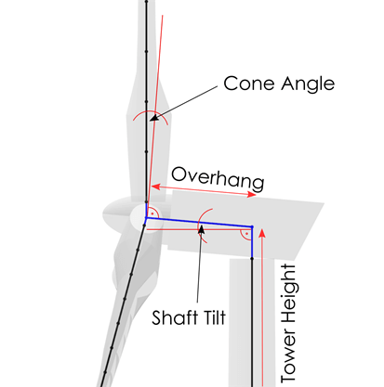
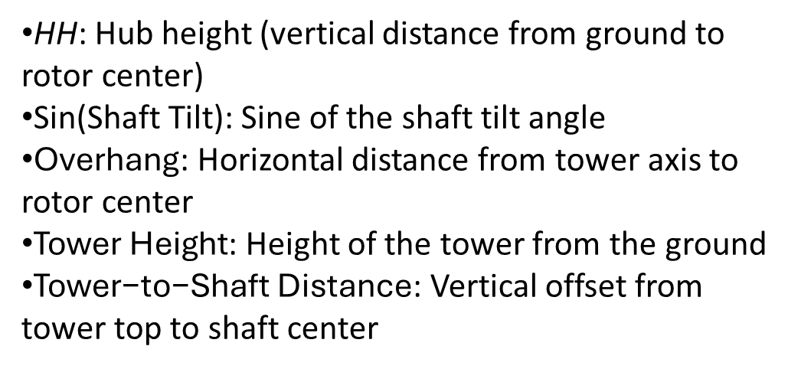
Calculation for Hub Height
Important for OpenFAST and Turbsim Input file.
HH=sin(Shaft Tilt)×Overhang+Tower Height+Tower to-Shaft Distance
HH: Hub height (vertical distance from ground to rotor center)
Sin(Shaft Tilt): Sine of the shaft tilt angle
$\text{Overhang}$: Horizontal distance from tower axis to rotor center
$\text{Tower} \text{Height}$: Height of the tower from the ground
$\text{Tower}\text{−}\text{to}\text{−}\text{Shaft} \text{Distance}$: Vertical offset from tower top to shaft center
[1]
Sketch from Qblade documentation
Saurabh Jha - 770271

Slide 6
Simulation Settings
30 seconds of simulation.
DLC 1.2 wind fields with average of 8 m/s, 10 m/s and 12 m/s.
Only enabled Rotor DOF and First fore-aft tower bending-mode DOF.
Set initial conditions of rotor speed, pitch angle, tower top positions. So that turbine starts in steady state.
Running only feedback controller, no Lidar-assisted controller.
Saurabh Jha - 770271

Slide 7
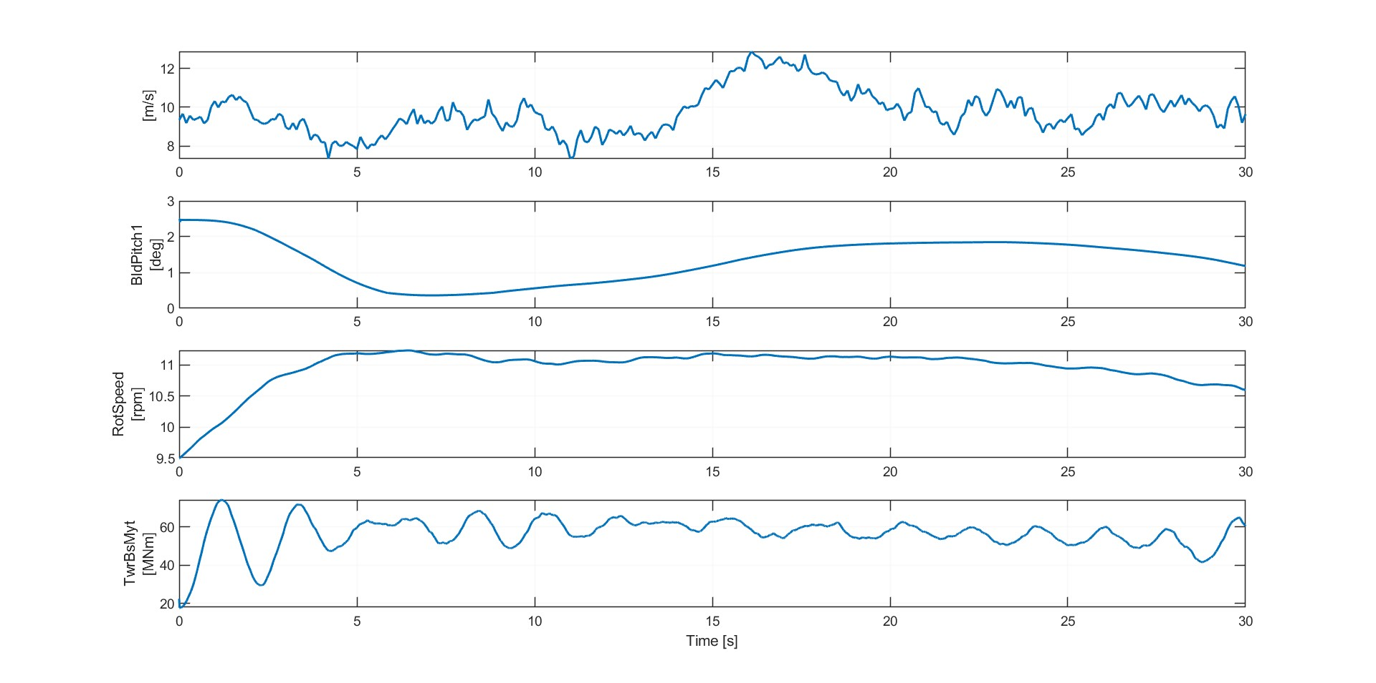
Result 1
Simulation results for IEA 3.4 MW with feedback control. 8 m/s wind field for DLC 1.2
Saurabh Jha - 770271

Slide 8
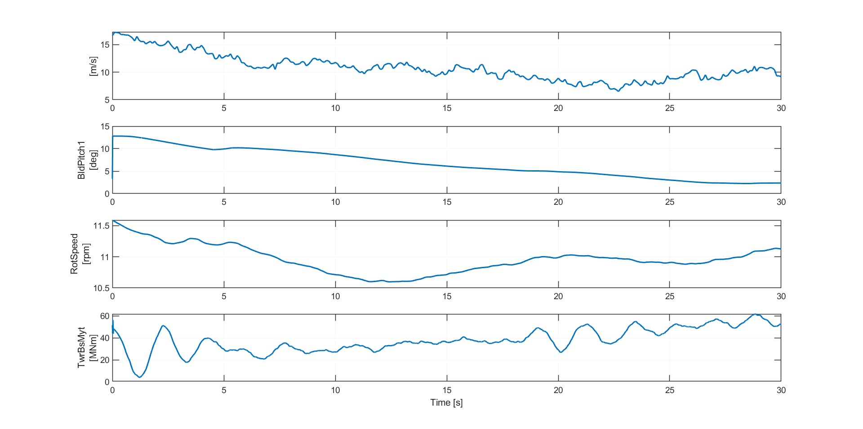
Result 2
Simulation results for IEA 3.4 MW with feedback control. 10 m/s wind field for DLC 1.2
Saurabh Jha - 770271

Slide 9
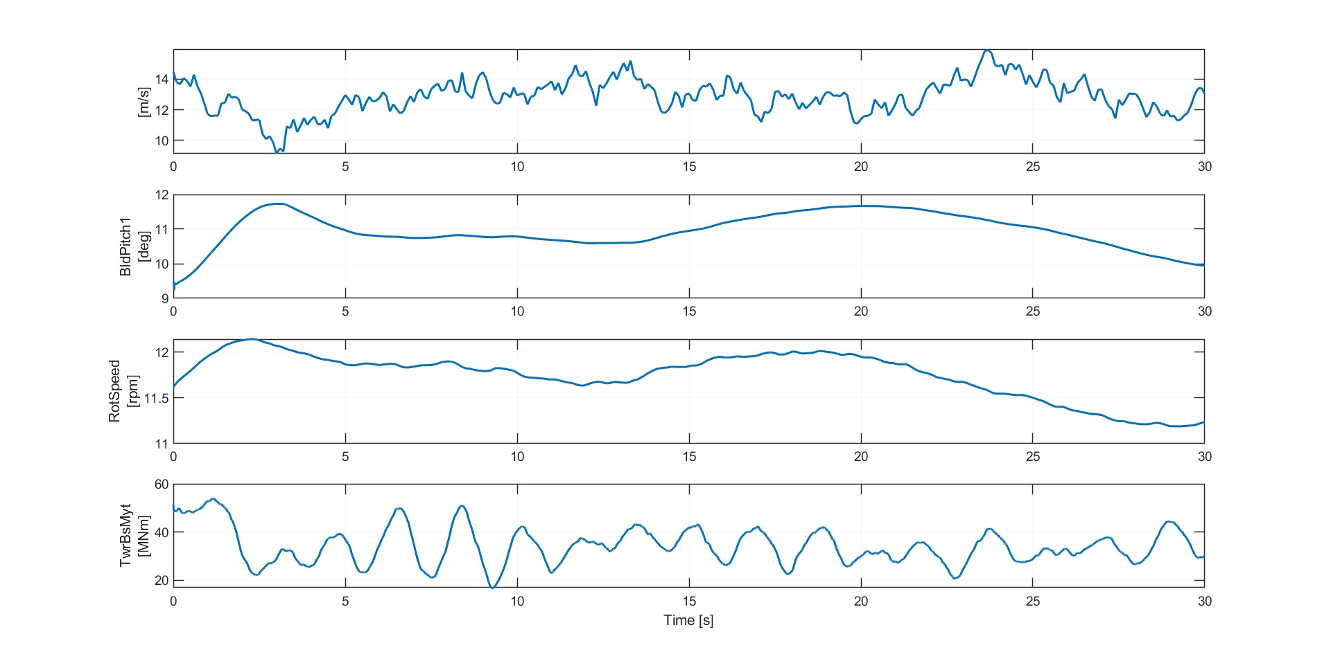
Result 3
Simulation results for IEA 3.4 MW with feedback control. 12 m/s wind field for DLC 1.2
Saurabh Jha - 770271

Slide 10
Conclusion
Successfully generated wind fields.
Run examples of DLC 1.2 simulation.
Next week:
Run full DLC 1.2 simulations, with different seeds and wind speeds.
Understand and apply cost calculation for controllers.
Saurabh Jha - 770271

Slide 11
Bibliography – Feedback Controller
[1] “Aerodynamic Turbine Design — QBlade Documentation 2.0.6.4 documentation,” docs.qblade.org. https://docs.qblade.org/src/user/turbine/aerodynamic.html
Saurabh Jha - 770271

